Slide 1

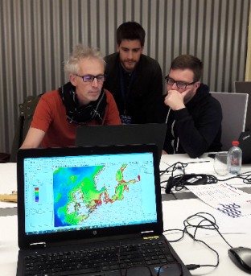



Willem Stolte
Joan Sala
Lilia Angelova
Johan Van de Wauw
Annette Zijderveld
EIA Wizard [Environmental Impact Assessment]

Slide 2


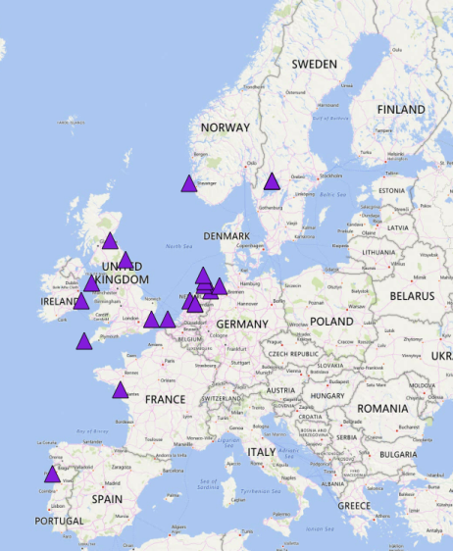
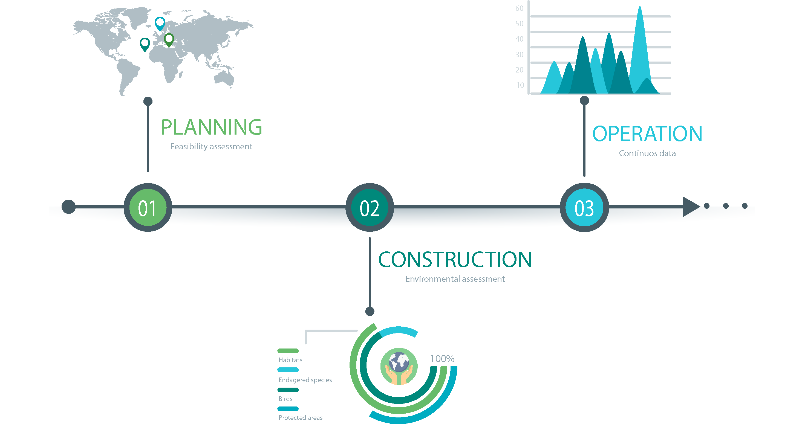
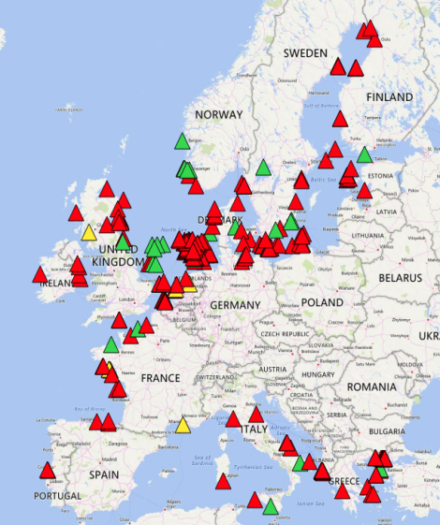
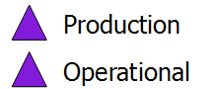
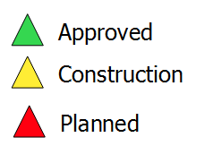
Background

Slide 3
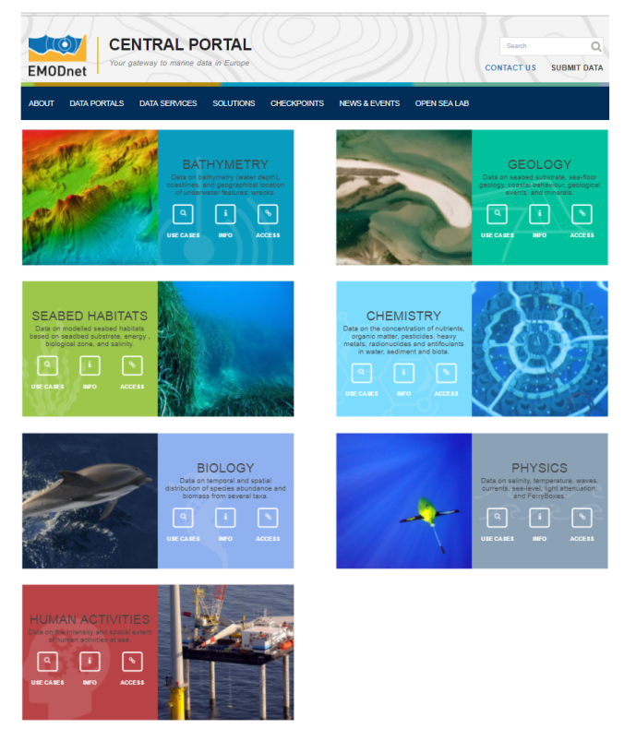
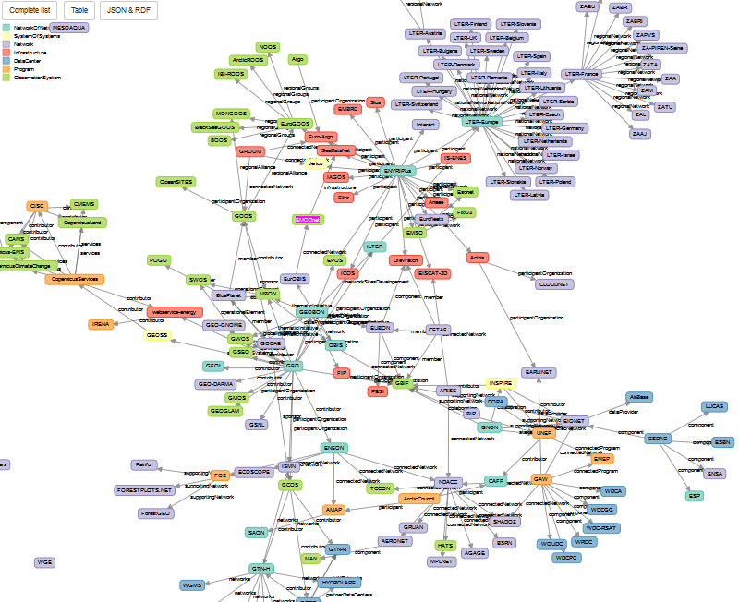
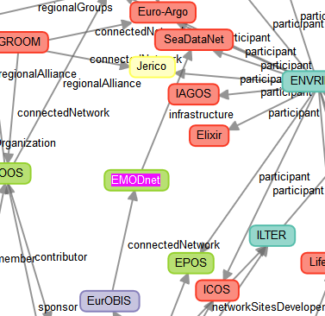

The problem

Slide 4
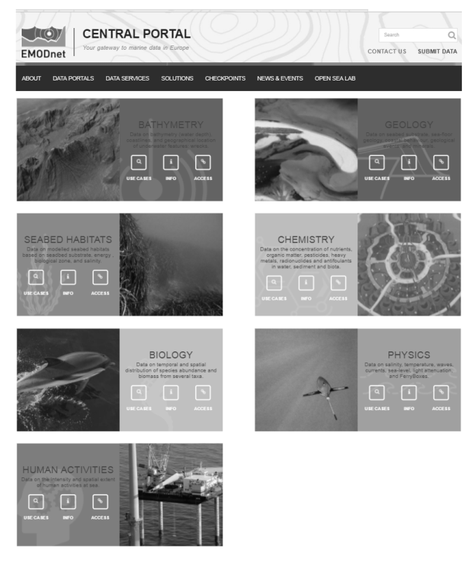
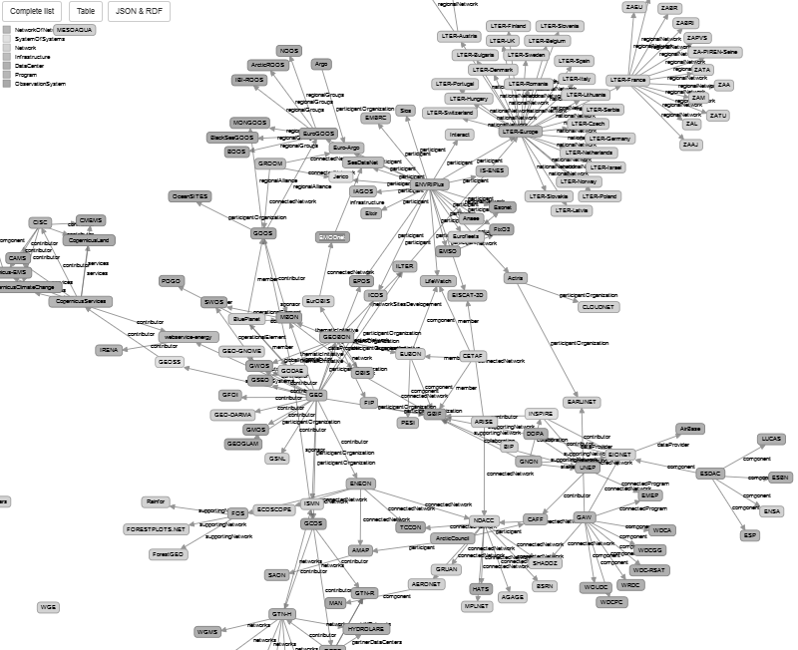
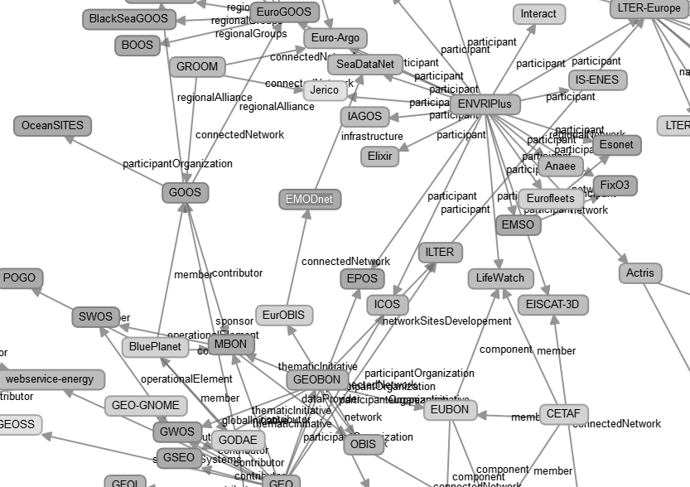

The problem
WE MAKE SURE YOU HAVE ALL RELEVANT DATA FROM EMODNET AND COPERNICUS AT THE NEEDED SCALE AND RESOLUTION READY TO BE USED IN YOUR DATABASE WITHIN 2 HOURS.

Slide 5
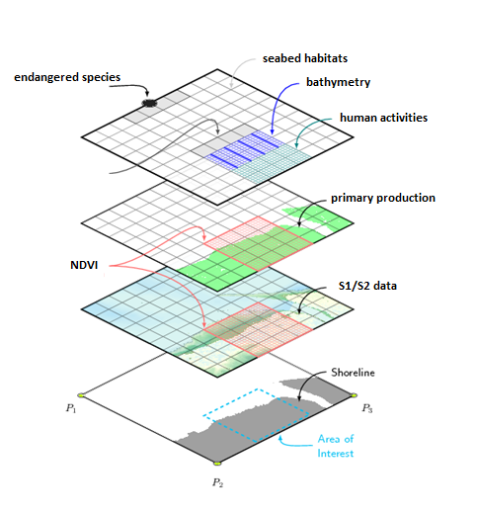
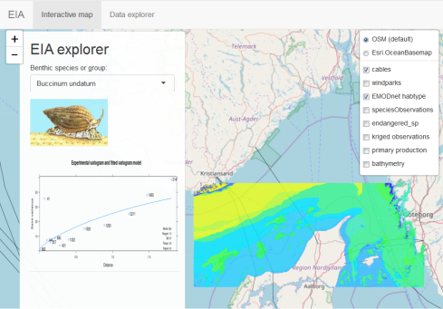
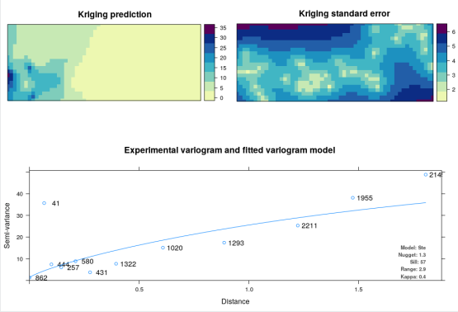
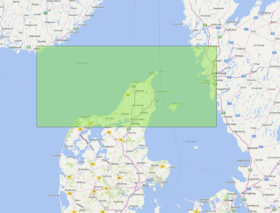
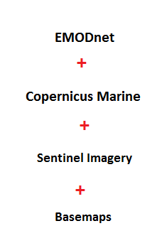
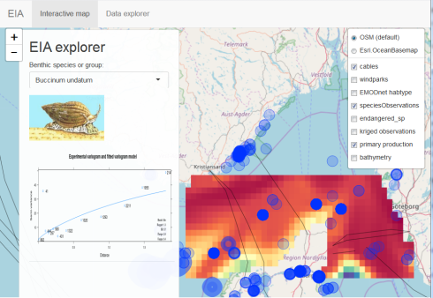

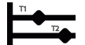

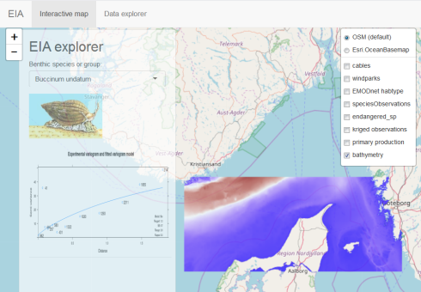
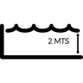



Wizard tool
Selection
Crop and download
Modelling
Visualization
Area of Interest
Time span
Depth

Slide 6


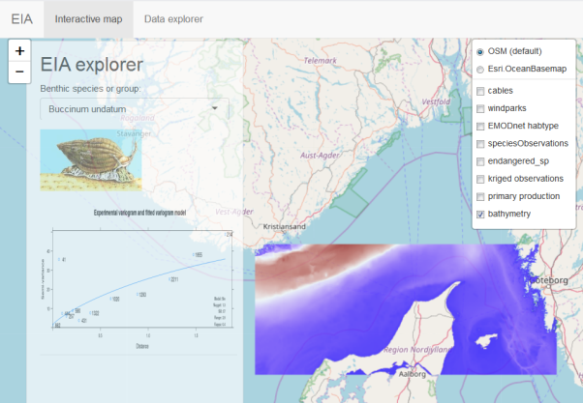


Live DEMO

Slide 7
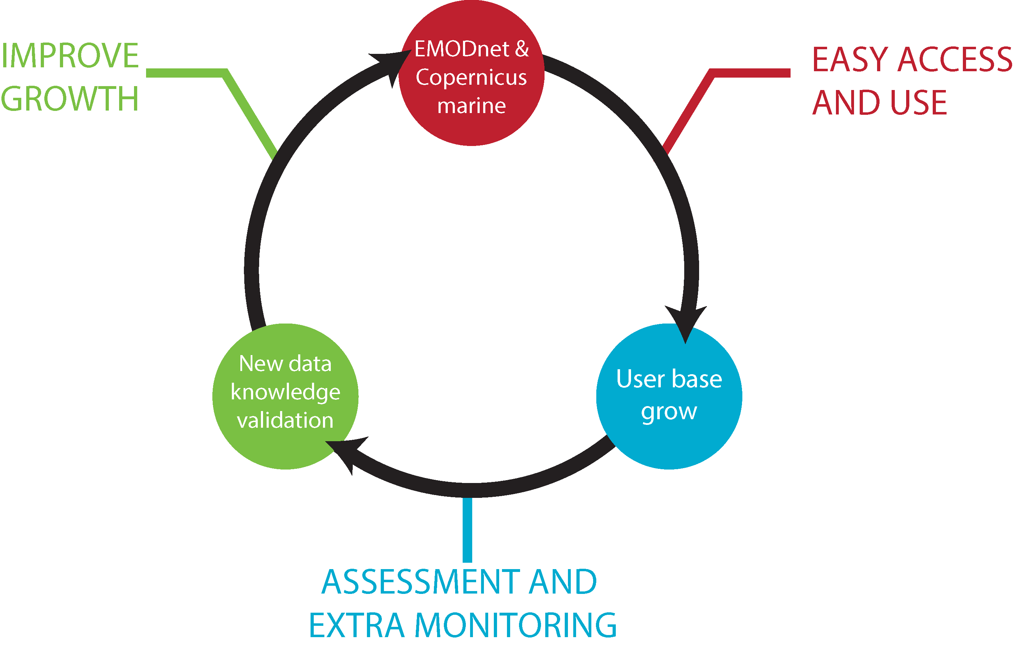




It will work
Experienced team
- We need this tool,
doing around
20 EIA’s per year
- We know EMODnet in all aspects, contributing to 5 different EMODnet projects
Enforce data and knowledge backstream
By (commercial) users
+
____________
Emodnet
Open data - but
Commercial use of tools for registered users only

Slide 8
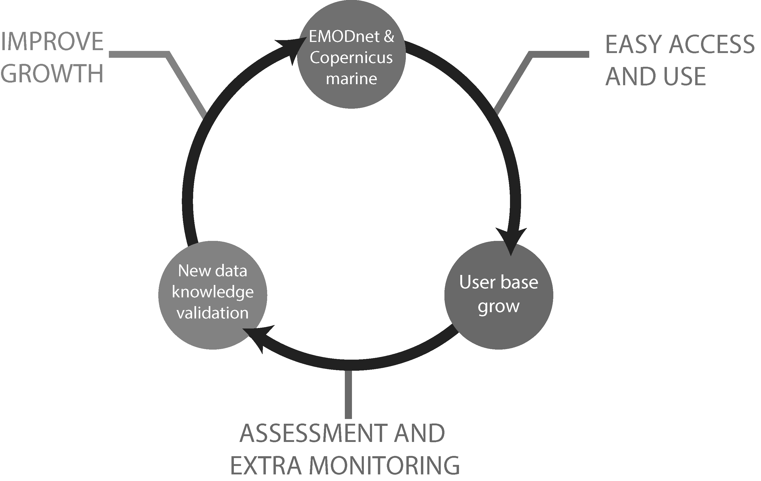


We need
Your commitment and the support of the whole EMODnet community!
A project to develop the tool in detail
A strategy for implementation of EIA wizard as preferred service for EIA, both to the consultant and the governmental organizations
A roadmap how to apply the wizard for other consultancy tasks
+ More users
+ more data
_____________
= better Emodnet
It will work for me,
We are doing around
20 EIA per year

